Slide 1

HR Department Analysis

Slide 2
Executive Slide
Data set link: https://drive.google.com/file/d/1N5pLaeRaihj_KZp7DNpF_05YSxlC8e8X/view?usp=sharing
Video Link: https://drive.google.com/file/d/1xltnDLtkk57QENi7xDB3Gyu1Ud7hhEdg/view?usp=sharing
Tableau Project Link: https://public.tableau.com/app/profile/yamini.ailani8053/viz/HRAnalytics_16278888496100/Dashboard1?publish=yes
What is HR analytics?
What we drive value from HR analytics?
Recruitment
Payroll & Benefits
Employee satisfaction & Grievances
Performance management
Compliance to about laws
To know about attrition numbers
To know about satisfaction scores
Dept wise attrition numbers
Employee’s satisfaction scores
Reason for attrition numbers
Areas of low & high satisfaction scores

Slide 3
Introduction about HR analytics department
Whenever you go to a company for Interview process, there is a HR person who always Involved in the recruitment process, all the payrolls & benefits, your salary processing, rise in the salary, your bonuses all the process and these calculations are done by HR functions. They also take care of performance cycle of an employee. There are some very Important compliances, company needs to follows and HR has the responsibility to see , If the compliances to the labour laws and various kinds of laws of the country by followed.
So, for all of these we use HR analytics. In a nutshell analytics is a process, Where we trying to Identifying the solutions to the business problem using historical data.
We need HR analytics because we should be able to take informed decisions & should be proactive in our approach.
In this presentation you will see various chart that will highlights some of the reasons why attrition is may be high or low for a particular reason.
These charts are very helpful to identifying the patterns from attritions perspective along with that you will gain some key information so that the department head / department director will be more aware about what is going on in the department .

Slide 4
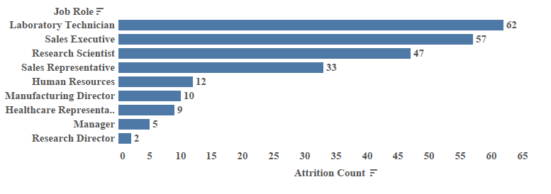
Attrition Count By Job Role
This chart illustrates Laboratory Technician is the job role where you have highest attrition count and Research Director having a low attrition count.

Slide 5
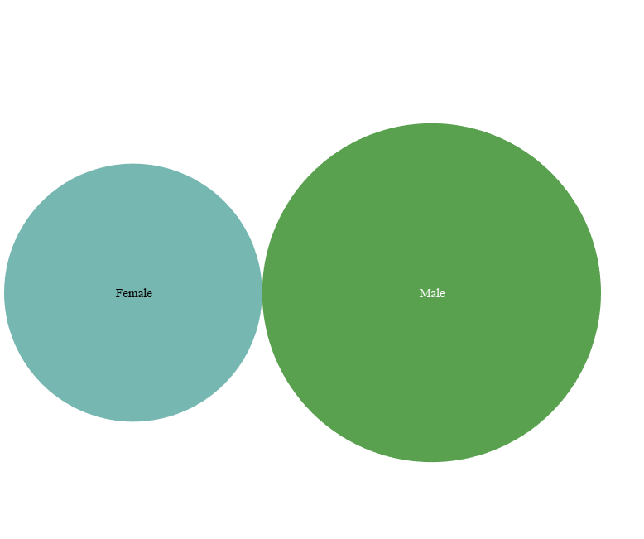
Attrition Count By Gender
Here you can see attrition count of male is greater that attrition count of female. Attrition count for male is 150 and for female is 87. So male employees leaving their job rather than female employees.

Slide 6
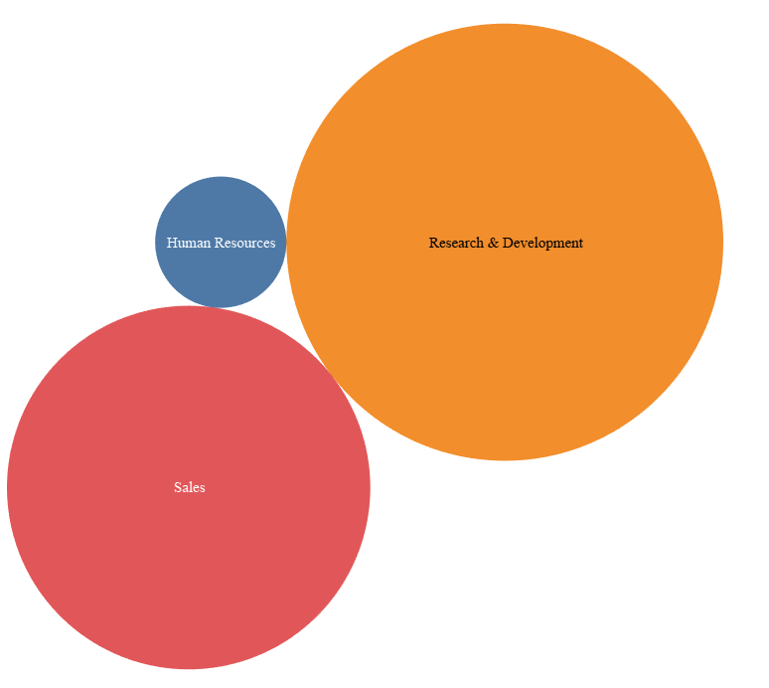
Attrition Count By Department
This chart shows that the attrition count of Research & Development department is very high and followed by Sales & Human Resources. Research & Development department has 133 attrition count, Sales has 92 attrition count and Human Resources has 12 attrition count.

Slide 7
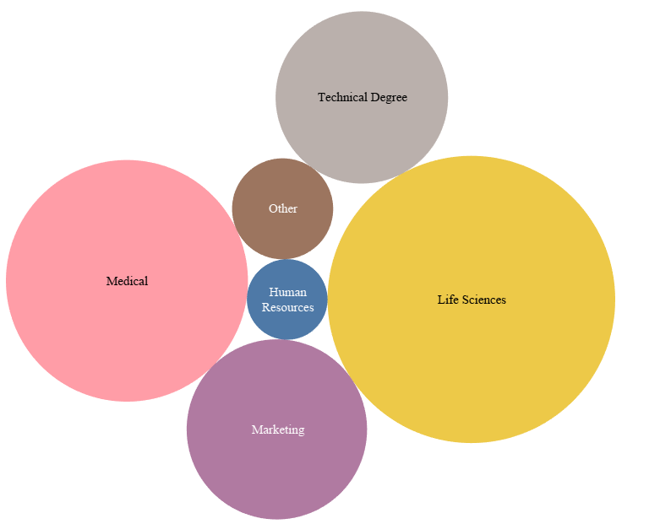
Attrition Count By Education Field
In this chart Life Sciences education field has the highest attrition count then followed by Medical, Marketing, Technical Degree, Human Resources and Other education field. Life sciences has 89 attrition count, Medical has 63 attrition count, Marketing has 35 attrition count, Technical has 31 attrition count and Human Resources has 7 attrition count.

Slide 8
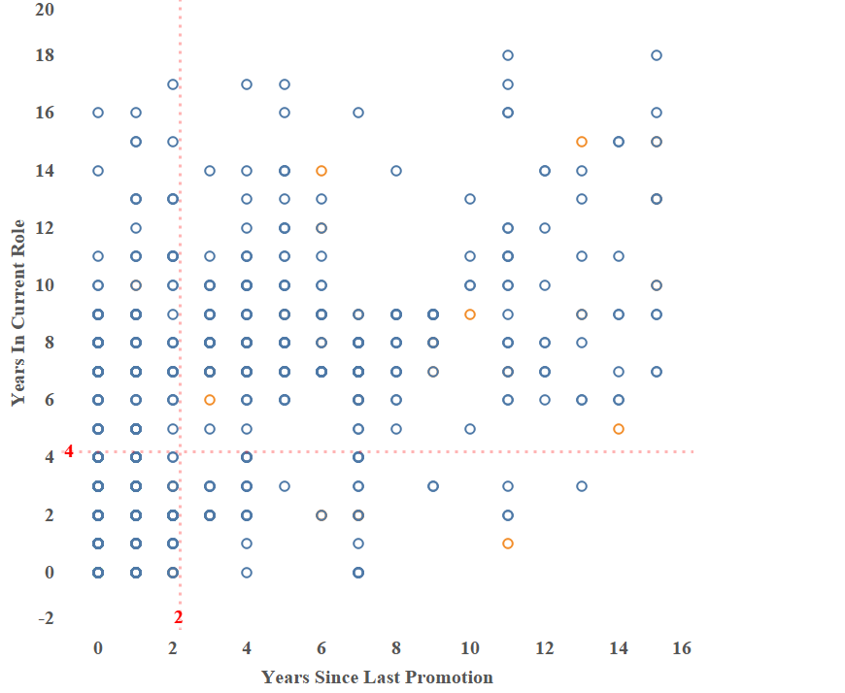
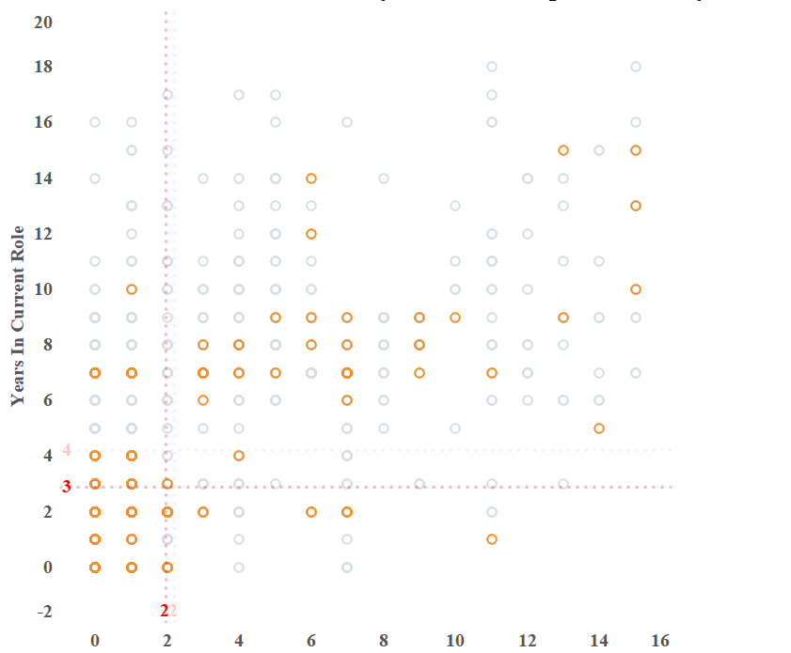
Attrition with respect to years since last promotion & years in current role
In this chart years since last promotion 0,1 & 2 and years in current role 1,2,3&4 this particular section is something interesting reason being is there are new employees and very recently got promoted so they are leaving may be probably because of getting more salary or because probably be they are new they want to try more creative things.
The next concern area indicates that people are leaving when they are in current role between 7-9 years and their last promotion has happened between 3-7 years.

Slide 9
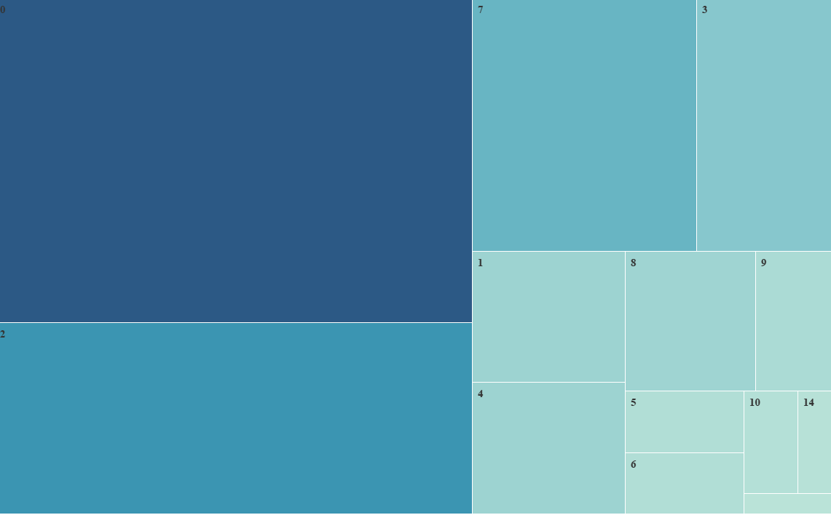
Attrition Relation With Years With Current Manager
In this chart when years with current manager is 0 then the highest no. of attrition when the no. of years with current manager is 2 then the second highest no. of attrition and followed by 7, 3 like this. So that basically implies that what’s going on with these two categories. Once we improve these two categories then we will cover attrition percentage in a company. When years with manager is 0 that means when the person is new, they are leaving. Not as much as with 1 because when the person passes it’s one year they will be with the current manager as they move on that means they are spending more time with manager they are leaving the company. So, this is what the chart telling us.

Slide 10
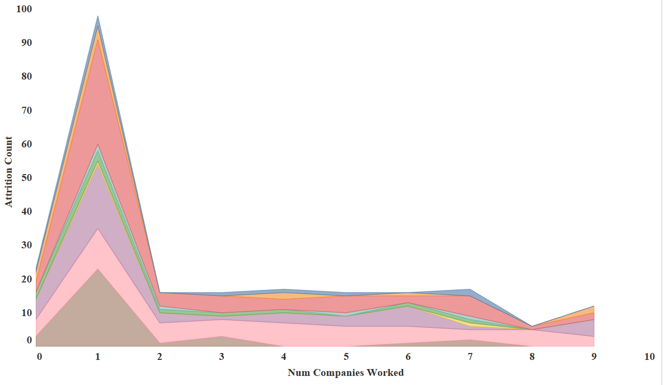
Attrition Relation With No. Of Companies Worked With Job Role
This is basically shows sales representative followed by sales executive, research scientist , In research scientist the no. of companies worked is just 1 but the attrition count is high and after that manufacturing director followed by manager, laboratory technician and so and so. This is much better picture which clearly shows whenever no. of companies worked is just 1 the attrition count is high.

Slide 11

Thank You

